Slide 1

Sae – aero micro capstone
Yaqoub Almounes – Budget Liaison
John Cowan – Website Developer
Josh Gomez – Project Manager
Mohammad Qasem – Document Manager
Michael Medulla – Client Contact

Slide 2
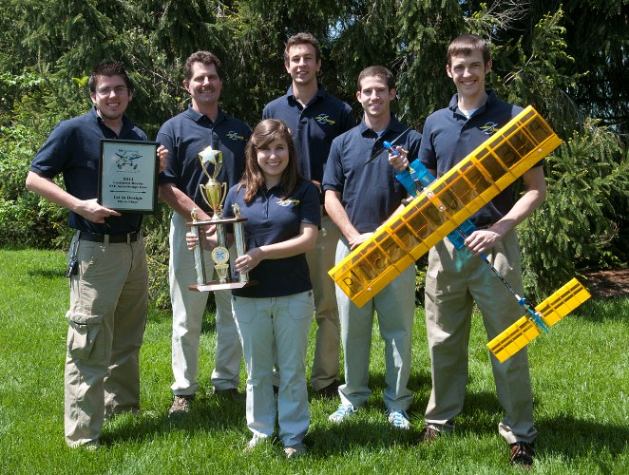
Project Description
SAE International holds annual Collegiate Aero Design competition
Universities from around the world showcase aircraft designs of various sizes to convey use of resources and efficient design
Micro class required to design a radio controlled aircraft which carries the highest payload fraction possible, while maintaining lowest empty weight possible.
Judges score each design based on written report, oral presentation, flight results.
Figure 1: Cedarville SAE Aero Design Team[1]

Slide 3
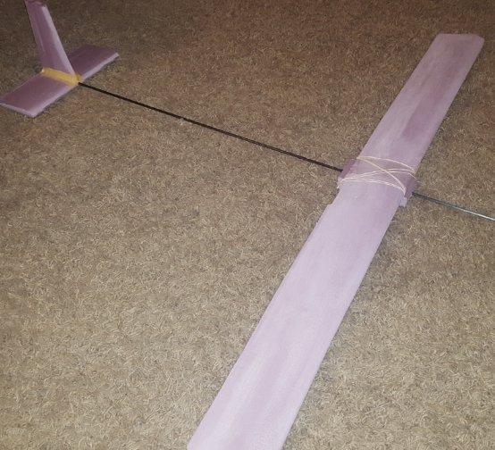
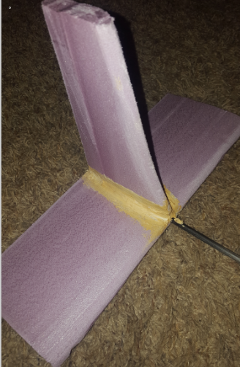
Design Description
Figure 3: Elevator and Rudder
Figure 2: Airfoil and Tail
Materials
  Fomular
    Large flexural/impact strength
  Carbon fiber rod
    30x bending strength of balsa
  Rubber bands
    Quick removal/ installation
  Caulking
    Strong and flexible
Streamline design
  Airfoil, elevator, and rudder
    Lift/ less drag

Slide 4
Design requirements
Customer Requirements | Weighting (5 most important) | How requirement is met
Safety | 5 | Functional motor shutoff switch (turns off within 5 seconds)
High Payload Fraction | 5 | Greater than 0.75 (at max load)
Durable | 3 | Able to withstand impact force of 22 N-s
Lightweight | 4 | Less than 3.18 kg
Maximum Lift | 5 | Greater than 32 N
Payload Bay | 5 | Installed under the center of the wings

Slide 5
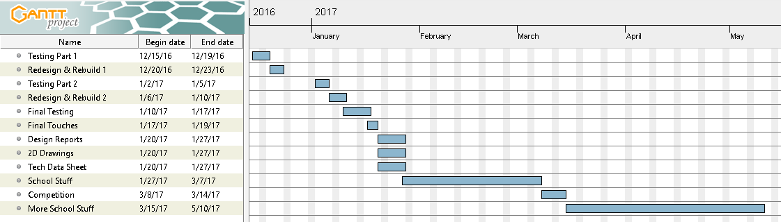
Schedule

Slide 6
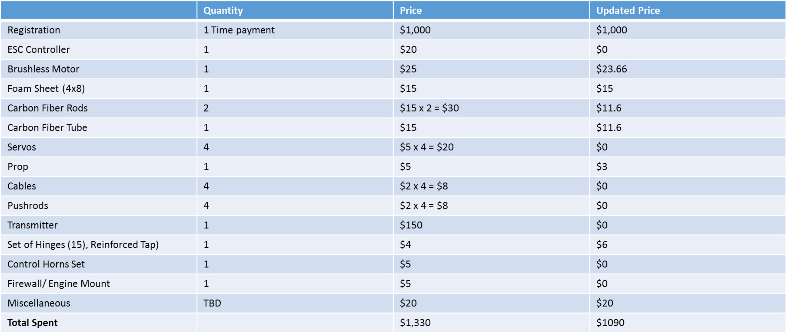
budget

Slide 7
References
[1] “Aero Design Team Soars to Success at Competition” Cedarville University,c 2011 [Online] Available: http://www.cedarville.edu/Offices/Public-Relations/CampusNews/2011/Aero-Design-Competition.aspx

Slide 8
Thank you

